Slide 1
Lecture 2
Data representation
Computing platforms
Novosibirsk State University
University of Hertfordshire
D. Irtegov, A.Shafarenko
2018

Slide 2
Finite length binary numbers
CdM-8 memory cells and registers have 8 bits
They cannot represent arbitrary numbers
Maximal unsigned number is 255
  (we will discuss signed numbers later today)
255+1=0.
  Actually, no. 255+1=0+carry bit
This is very different from arithmetic you study in Calculus

Slide 3
32- and 64-bit computer are also finite
Maximal unsigned 16-bit number is 65535
Maximal unsigned 32-bit number is approximately 4 000 000 000
Maximal unsigned 64-bit number is approximately 16 E18
How to estimate this?

Slide 4
How to estimate big powers of two?
Powers of two from 1 to 10 are easy to remember
  And I think every IT specialist must remember them
Powers from 1 to 6 are school multiplication table. 2**6=8**2=64
2**8 = 256 (maximal unsigned byte value+1) - useful to remember
2**10=1024 (approximately thousand) – also useful and easy to remember
You can remember values of 2**9 and 2**7 or calculate them as needed
2**32=(2**2)*(2**30)=4*((2**10)**3)
~=4*(1000**3)=4 000 000 000
2**64~=(2**4)*(1000**6)=16*1E18

Slide 5
Megabytes, kilobytes, etc
2**10 bytes = 1024 bytes = 1 kilobyte
Normal people think kilobyte has 1000 bytes,
programmers think kilogram has 1024 grams
1024 kilobytes = 1Megabyte ~= 1 000 000 bytes
1024 Megabytes = 1 Gigabyte
1024 Gigabytes = 1 Terabyte
Some bad people (like HDD makers) use decimal Mega.. Giga and Tera prefixes instead of binary. Sometimes they designate this by using Tib instead of Tb. Sometimes they not. Beware

Slide 6
Can we work with long numbers on CdM8?
Yes we can.
There is a carry bit in CdM8 PS register.
I mentioned it when we discussed what 255+1 means.
255+1=127+128=...=0+C bit
In most modern CPUs it can be used for branch conditions
adc instruction, which adds two registers and a carry bit
You can use it to implement an arbitrary length integer calculation
  Well, not bigger than 8096 bits

Slide 7
What about negative numbers?
?

Slide 8
Simple idea: sign bit
Use high bit to represent a sign
24=00011000, -24=10011000
Aka signed magnitude or sign-and-magnitude
Was popular in early computers
Biggest number is 127, smallest number is -127
Two representations of 0: 00000000 and 10000000
We will understand later why it got out of fashion

Slide 9
More complex idea: two complement
To calculate the 2's complement of an integer,
Pad it to given word length (8 bits in CdM-8)
Invert all bits
by changing all of the ones to zeroes
and all of the zeroes to ones
(also called 1's complement),
And then add one.
2’complement of 1 is ^(00000001)+1=11111110+1=11111111
Why?

Slide 10
Really, why use 2’complement?
1+2’complement(1)=0
N+2’complement(N)=0 for all -1<N<128
K+2’complement (N)=K-N for most N and K fitting in 7 bits
So, if we treat 2’complement(N)
as –N, we can add negative
numbers as we do with
positive (unsigned)
Great simplification of hardware
No -0 value
Extra value for negative numbers (smallest possible is -128)

Slide 11
So, what is exact value of N and V flags in PS?
For most CdM-8 commands, Z is 1 iff the operation result is 00000000
N flag is = topmost bit of the result (bit 8)
C flag is equal to carry to bit 9
V flag is 1 if you added two positive 2’complement numbers
and got negative
or if you added two negative 2’complement numbers
and got positive
It is known as overflow or sign loss
Or this can be expressed in other way:
carry to bit 9 is not equal to carry to bit 10.
V is for oVerflow. In some other CPUs it is called O.

Slide 12
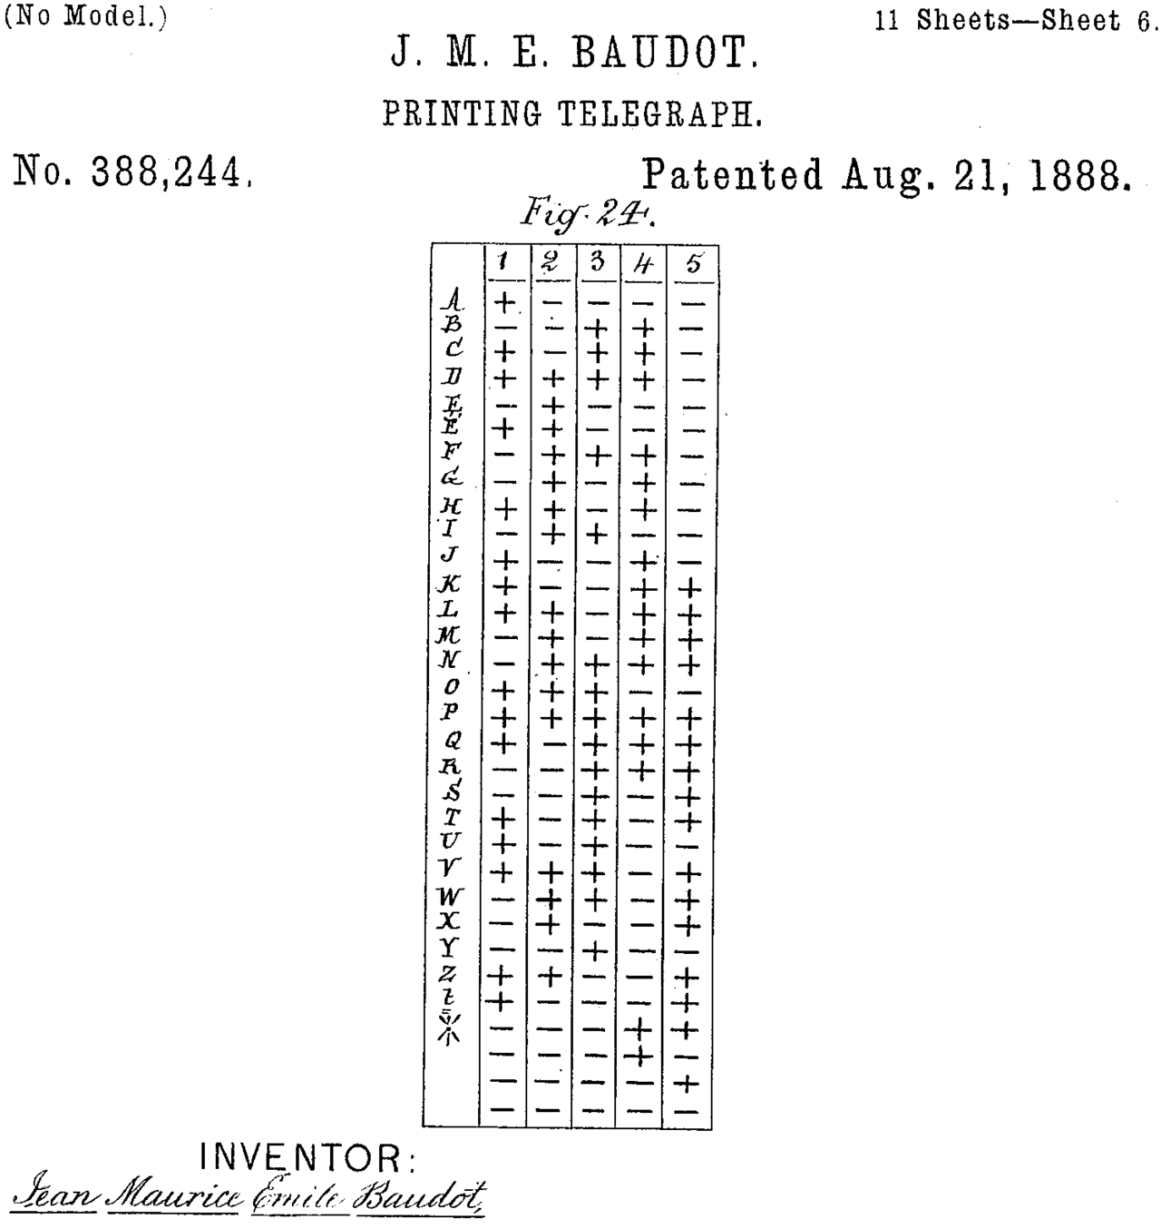
Text representation
First widely used binary communication system was Baudot printing telegraph
Baudot code was used until 1924 when if was superseded by 6-bit ITA2 encoding
Modulation unit (Baud) is named after Baudot

Slide 13
American Standard Code for Information Interchange
ASCII
7-bit code standardized by American Standard Association (now ANSI) in 1963.
Latin encoding used by most modern computers
Had 8-bit extensions to support national scripting systems (European characters, Greek, Cyrillic, Hebrew)

Slide 14
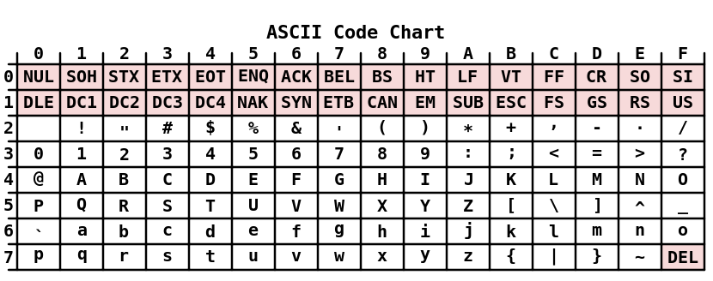
ASCII table

Slide 15
Unicode
Designed to represent all writing systems known to humanity
Including historical, like Egyptian hierogliphs
Including fictionary, like Klingon and Quenya
Several translation formats, including UTF-32, UTF-16 and UTF-8
UTF-32 can represent any Unicode codepoint directly
UTF-16 uses so called ”surrogate pairs” to represent some characters
UTF-8 – ASCII-compatible prefix encoding

Slide 16
UTF-8
Number of bytes | Bits for code point | First code point | Last code point | Byte 1 | Byte 2 | Byte 3 | Byte 4
1 | 7 | U+0000 | U+007F | 0xxxxxxx
2 | 11 | U+0080 | U+07FF | 110xxxxx | 10xxxxxx
3 | 16 | U+0800 | U+FFFF | 1110xxxx | 10xxxxxx | 10xxxxxx
4 | 21 | U+10000 | U+10FFFF | 11110xxx | 10xxxxxx | 10xxxxxx | 10xxxxxx

